Slide 1
Lung Cancer
Prediction
ITCS 3156 - Project Proposal
Presented by
Gustavo Carpio Romero
Derek Wang

Slide 2
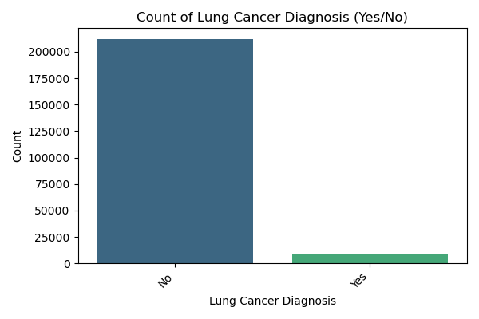
Project overview
Objective
Motivation
Challenges:
To develop a machine learning-based model for predicting lung cancer risk using a comprehensive dataset of demographic and environmental factors.
The dataset has a significant class imbalance, making it difficult to accurately predict the positive class (lung cancer diagnosis).
Lung cancer is a leading cause of death worldwide. Early and accurate detection is critical for improving patient outcomes. This project explores the use of machine learning to identify high-risk individuals.
Notes:
Script: "To give you a brief overview of our project, we aimed to develop a machine learning model to predict the risk of lung cancer. We were motivated by the fact that lung cancer is a leading cause of death worldwide and that early detection is crucial for improving patient outcomes. A key challenge we faced was the significant class imbalance in our dataset, which made it difficult to accurately predict a positive lung cancer diagnosis."
Visual Cue: As you discuss the class imbalance, you can point to the bar chart on the slide, which visually represents this challenge.

Slide 3
Dataset
Original Features Used for Model Training:
Age
Gender
Smoker
Years_of_Smoking
Cigarettes_per_Day
Passive_Smoker
Family_History
Air_Pollution_Exposure
Occupational_Exposure
Indoor_Pollution
Healthcare_Access
Early_Detection
Adenocarcinoma_Type
Engineered Features:
total_cigarettes_smoked
smoking_age_interaction
environmental_risk_score (Air_Pollution_Exposure, Occupational_Exposure, & Indoor_Pollution.)
Features That Were Dropped:
ID
Country
Population_Size
Cancer_Stage
Survival_Years
Treatment_Type
Annual_Lung_Cancer_Deaths
Lung_Cancer_Prevalence_Rate
Mortality_Rate
Developed_or_Developing
Dataset:
Size: 220,632 samples
Features:
Lung Cancer Dataset (Kaggle) -
Lung Cancer Prediction Dataset
This dataset offers valuable insights into lung cancer by providing detailed information on 220,632 individuals from 25 of the world's most populated countries.
Notes:
"The dataset we used is from Kaggle and contains valuable insights on 220,632 individuals from 25 of the world's most populated countries. It includes original features that were used for our model training, such as age, gender, smoking habits, and years of smoking. We also engineered new features like a 'total_cigarettes_smoked' score, a 'smoking_age_interaction' term, and an 'environmental_risk_score' to better capture important risk factors. There were also features that we dropped because they were either irrelevant or had too many missing values."

Slide 4
Preprocessing Steps:
Initial Cleaning: We dropped columns with a high number of missing values (e.g., cancer_stage, treatment_type) and other irrelevant features like ID, Country, Cancer_Stage, Population_Size, and etc.
Feature Engineering: We created three new features to capture important risk factors:
total_cigarettes_smoked: Calculated as years_of_smoking * cigarettes_per_day * 365.
smoking_age_interaction: An interaction term between Age and Years_of_Smoking.
environmental_risk_score: A composite score from Air_Pollution_Exposure, Occupational_Hazards, and Indoor_Pollution_Exposure.
Categorical Encoding: LabelEncoder was used to convert categorical features like Gender and our target variable, lung_cancer_diagnosis, into a numerical format.
Feature Scaling: Applied StandardScaler to normalize numerical features.
Addressing Class Imbalance: Employed resampling techniques like SMOTE, SMOTENN, ADASYN, and RandomOverSampler to balance the dataset.
Notes:
Script: "Before training our models, we took several key preprocessing steps. First, we performed initial cleaning by dropping irrelevant columns and those with a high number of missing values. We then created three new engineered features: 'total_cigarettes_smoked,' which is the total number of cigarettes an individual has smoked throughout their life; 'smoking_age_interaction,' which is an interaction term between age and years of smoking; and an 'environmental_risk_score' which is a composite score based on air pollution, occupational hazards, and indoor pollution. We also used LabelEncoder for categorical features like gender and our target variable, and applied StandardScaler to normalize our numerical features. Finally, to handle the class imbalance issue, we used resampling techniques such as SMOTE, SMOTENN, ADASYN, and RandomOverSampler.

Slide 5
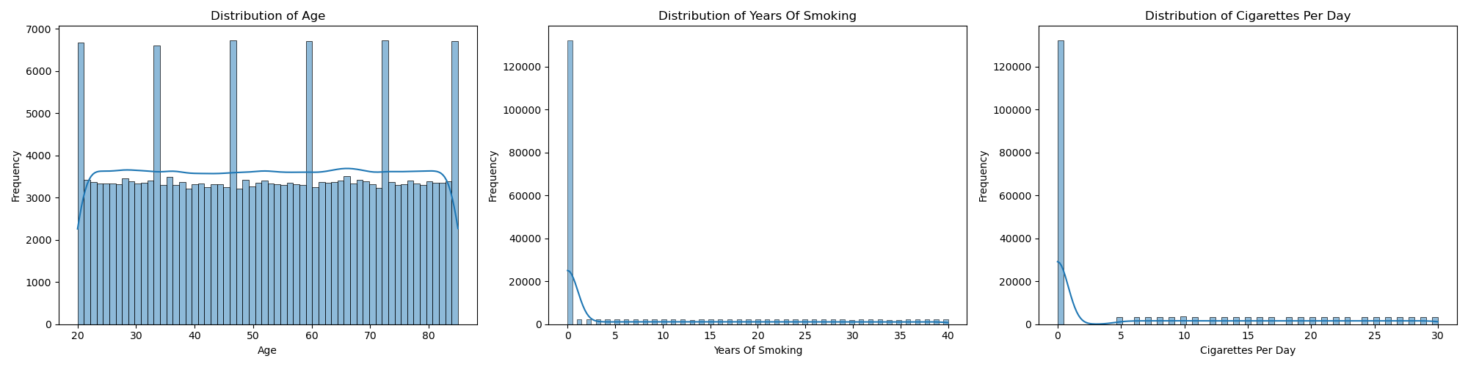
Numerical features distribution
This set of histograms shows the distribution of key numerical features such as Age, Years_of_Smoking, and Cigarettes_per_Day. It helps to visualize the data characteristics and reveals that most individuals in the dataset are in the lower range for smoking-related features, which adds to the difficulty of the prediction task.
Notes:
"This slide shows the distribution of our key numerical features: Age, Years of Smoking, and Cigarettes per Day. As you can see from the histograms, most individuals in the dataset are in the lower range for smoking-related features. This visualization highlights the difficulty of the prediction task due to the high number of non-smokers and individuals with low smoking years."

Slide 6
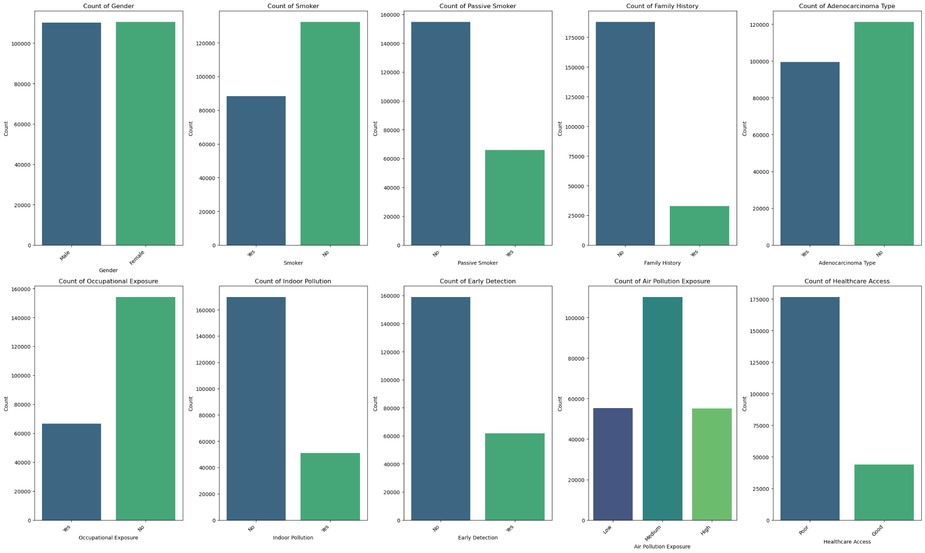
Count Plots for Categorical Features

Slide 7
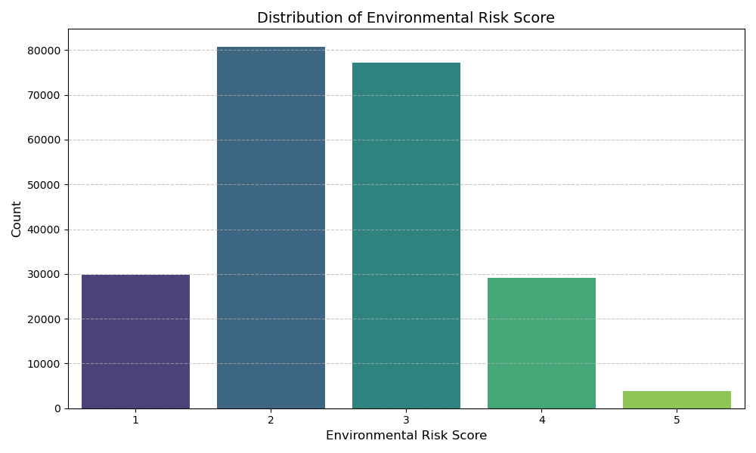

Slide 8
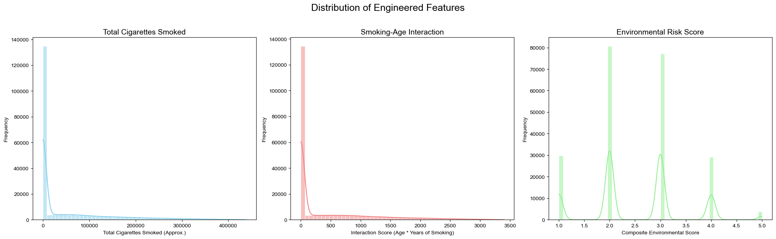

Slide 9
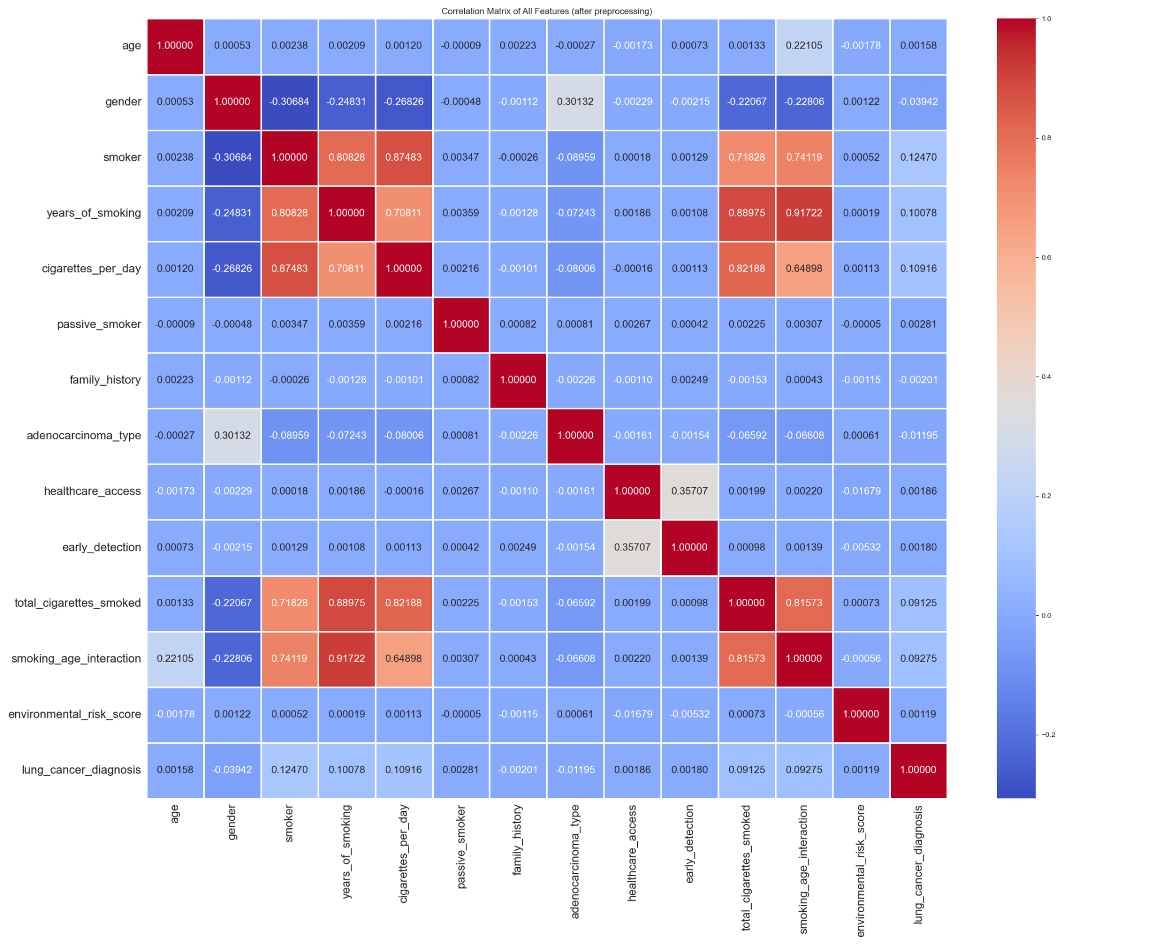
Correlation Matrix of Features

Slide 10
Machine Learning Models and Approach
We implemented and evaluated a diverse set of machine learning models for our binary classification task. Our approach was to establish a baseline with simple models before moving on to more complex, high-performance algorithms.
Model Selection Rationale:
Logistic Regression: Chosen for its simplicity, efficiency, and interpretability. It serves as an ideal baseline for comparing linear relationships.
Linear SVM: Selected for its effectiveness in high-dimensional spaces and its ability to find an optimal decision boundary.
Decision Tree & Random Forest: Decision trees are intuitive, while Random Forest, an ensemble of multiple trees, helps reduce overfitting and improves generalization.
Gradient Boosting (and XGBoost): These are powerful ensemble methods known for their high predictive accuracy. They build models sequentially, with each new model correcting the errors of the previous ones.
K-Nearest Neighbors (KNN) & Gaussian Naive Bayes: Included to explore different types of classification approaches, specifically a distance-based method and a probabilistic method.
Notes:
Derek - Model and Explain purpose

Slide 11
Model Output and Evaluation:
Given the class imbalance, we focused on more than just overall accuracy. We used the following metrics and outputs to evaluate our models:
F1-score: This is the harmonic mean of precision and recall. It is a critical metric for imbalanced datasets because it provides a balanced measure of a model's performance on the positive class.
Recall (Sensitivity): This metric measures the percentage of actual positive cases (lung cancer) that were correctly identified. In a medical context, maximizing recall is crucial to avoid false negatives.
Classification Report: Provides a comprehensive breakdown of precision, recall, and F1-score for each class.
Confusion Matrix: A visualization that shows the number of true positives, false positives, true negatives, and false negatives.

Slide 12
Model Comparison Output
Model | Resampling Technique | Accuracy | F1-score (Cancer) | Recall (Cancer)
Random Forest | SMOTE | 0.9009 | 0.0553 | 0.0714
Logistic Regression | SMOTE | 0.7004 | 0.1194 | 0.5
Linear SVM | SMOTE | 0.6988 | 0.121 | 0.5106
Gradient Boosting | SMOTE | 0.7566 | 0.1185 | 0.4029
XGBoost | SMOTE | 0.9561 | 0.0102 | 0.0056
Random Forest | ADASYN | 0.9001 | 0.0524 | 0.0681
Logistic Regression | ADASYN | 0.6958 | 0.1182 | 0.5022
Linear SVM | ADASYN | 0.6936 | 0.1215 | 0.5218
Logistic Regression | RandomOverSampler | 0.6167 | 0.1276 | 0.6903
Linear SVM | RandomOverSampler | 0.6167 | 0.1276 | 0.6903

Slide 13
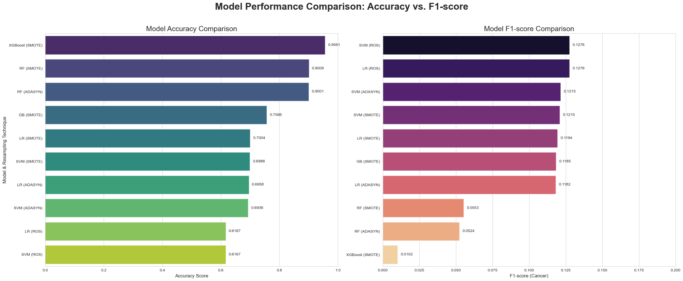
Model Comparison Output

Slide 14
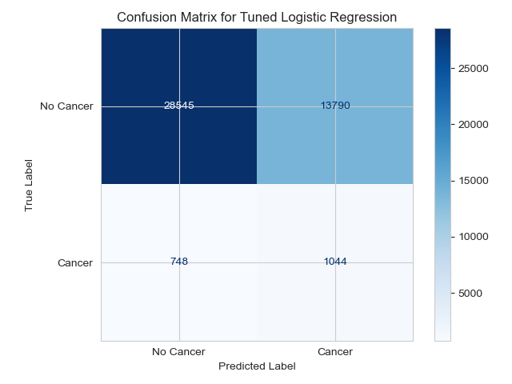
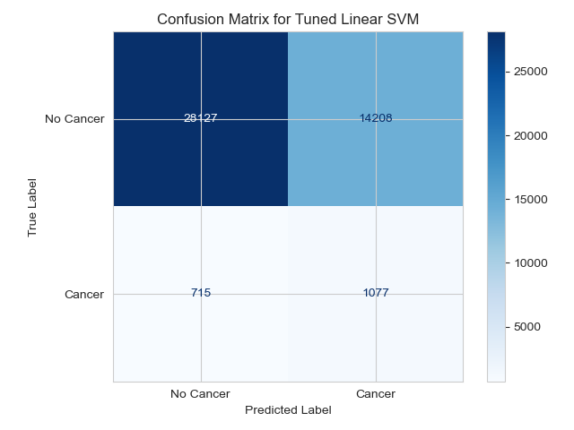
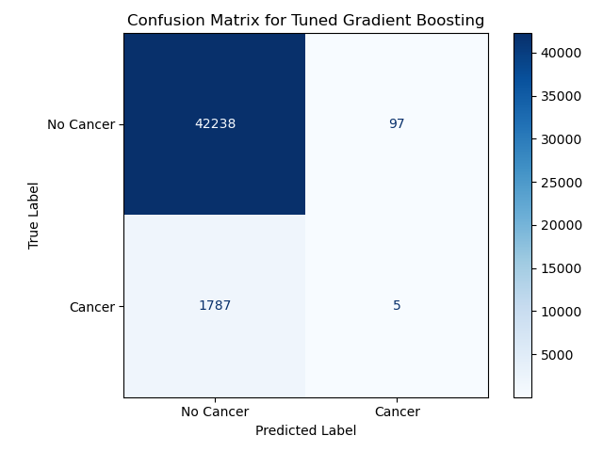

Slide 15
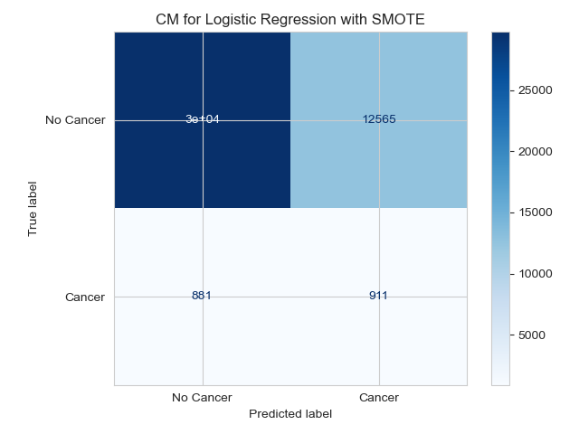
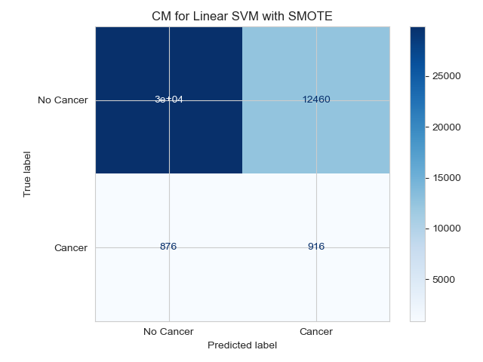
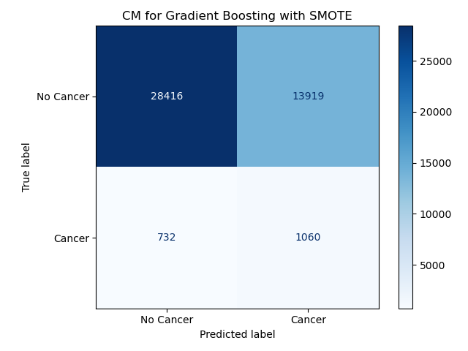
Experiments
We conducted experiments to find the best model and method for handling class imbalance.
Experiment 1 (SMOTE Resampling):
Winner: Gradient Boosting with an F1-score of 0.1264.

Slide 16
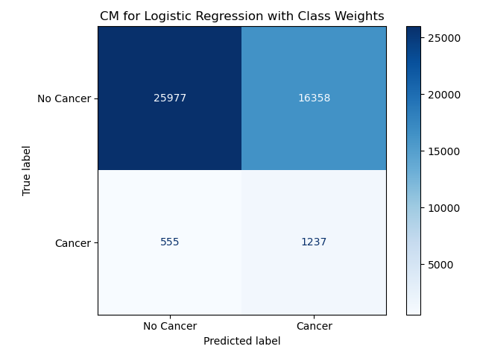

Experiments
Experiment 2 (Class Weights):
Winners: Logistic Regression and Linear SVM with an F1-score of 0.1276.
This technique yielded slightly better F1-scores for our top models.

Slide 17
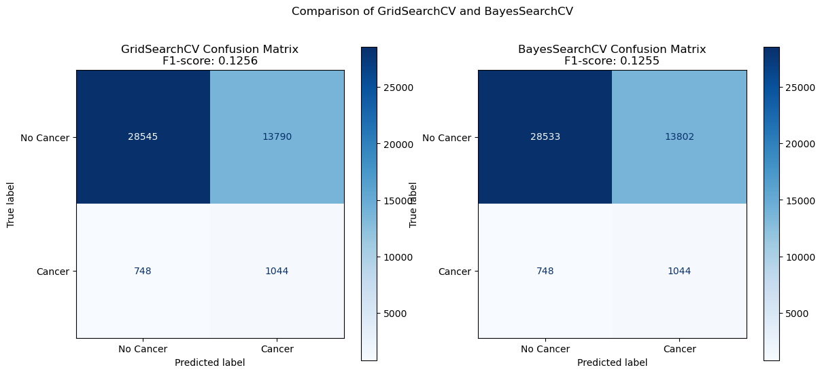

Slide 18
Summary
We built models that can predict lung cancer risk, with Logistic Regression and Linear SVM performing best on the F1-score metric.
The overall accuracy of our best models (Logistic Regression and Linear SVM) was 0.6167, which might seem low. However, this number is misleading due to the severe class imbalance. A model that simply predicted "No Cancer" for every single person would achieve an accuracy of over 90%, but would be completely useless.
A better measure of accuracy for this task is the F1-score, which balances the model's ability to correctly identify positive cases (recall) with its ability to avoid false alarms (precision). Our best models achieved an F1-score of 0.1276. This indicates the model has some predictive power, but there is significant room for improvement.

Slide 19
Ideas
Personalized Risk Assessment Tool:
Application: Transform the model into a user-friendly web or mobile application. Individuals could input their personal risk factors (age, smoking history, etc.) and receive a personalized lung cancer risk score.
Extension: The application could go a step further by providing data-driven recommendations, such as suggesting a smoking cessation program or a conversation with a doctor based on the calculated risk.
Targeted Public Health Interventions:
Application: Public health organizations could use the model to identify and target high-risk populations more effectively. Instead of a one-size-fits-all approach, resources could be allocated to communities or demographics with the highest predicted risk.
Extension: The model could be used to simulate the impact of policy changes, such as a reduction in air pollution, on overall lung cancer prevalence within a given population.

Slide 20
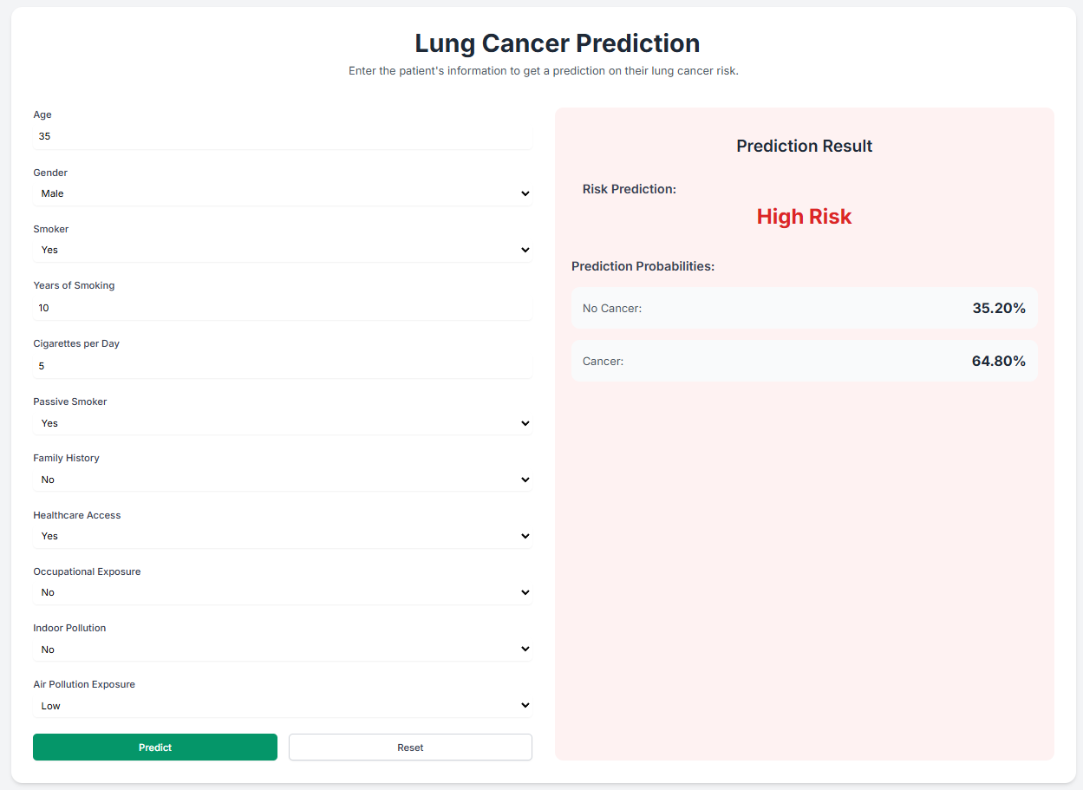
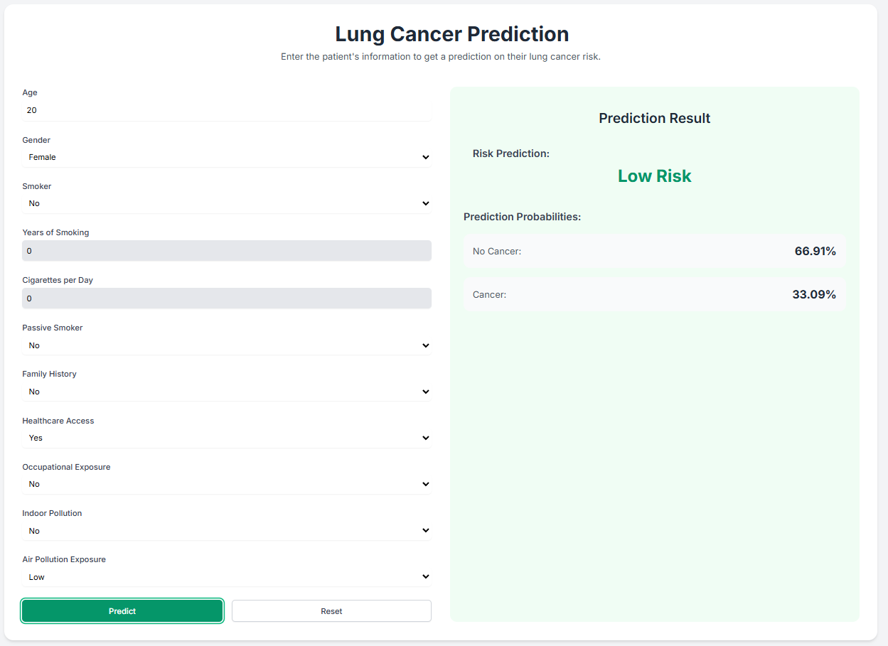
Demo Image

Slide 21
Thank you!
Questions?
Please reach out to
name@example.com

